Slide 1

5
4
Priority Task Manager
Streamlining Task Management with Intuitive Prioritisation
3
2
1

Slide 2

Objective
To provide an easy-to-use interface for task prioritisation and management.
Key Features
Add tasks with priority levels (High, Medium, Low).
Set task due dates with a calendar interface.
Toggle task completion status.
Filter completed and pending tasks.
5
4
Priority Task Manager
3
Streamlining Task Management with Intuitive Prioritisation
2
1

Slide 3
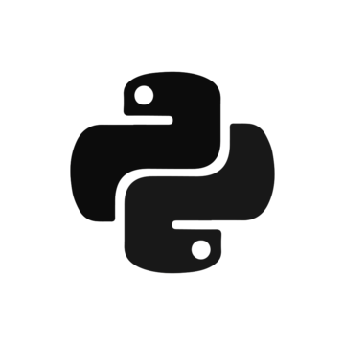
Python Libraries Used
PyQt5
For creating the graphical user interface (GUI).
Provides widgets like QListWidget, QComboBox, and QDateEdit.
sys
Used to handle application runtime.
5
Tools Used
4
QIcon and QBrush
For integrating icons and custom task styles.
QMessageBox
To display error, confirmation, and success messages.
Priority Task Manager
3
Streamlining Task Management with Intuitive Prioritisation
2
1

Slide 4
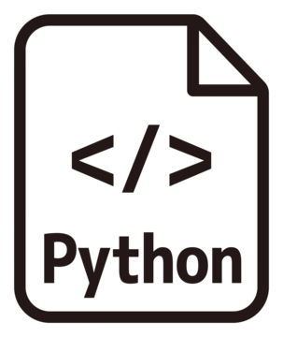
Code Structure
Classes
StartPage: Launch page with startup button.
TaskManagerGUI: Main GUI for task management.
Key Methods
addTask: Adds a new task to the list.
deleteTask: Deletes selected tasks.
toggleStatus: Toggles completion status.
updateTaskView: Filters tasks based on completion status.
5
4
Priority Task Manager
3
Streamlining Task Management with Intuitive Prioritisation
2
1

Slide 5

Demonstration of the Program
Startup Page
User-friendly entry point with a "Get Started" button.
Background image enhances the visual appeal.
Task Manager Interface
Add task details including name, priority, and due date.
View task list with color-coded priorities
Red for High
Yellow for Medium
Green for Low
Toggle task statuses (Pending/Completed).
Filter tasks using the "Show Completed" checkbox.
5
4
Priority Task Manager
3
Streamlining Task Management with Intuitive Prioritisation
2
1

Slide 6
Conclusion
Limitations
No persistent storage; tasks are lost after closing.
Single-user interface; no multi-user support.
Future Improvements
Add database integration for persistent storage.
Enhance UI with drag-and-drop support.
Enable notifications for upcoming deadlines.
Challenges
Fine-tuning UI responsiveness and task list styling.
5
4
Priority Task Manager
3
Streamlining Task Management with Intuitive Prioritisation
2
1

Slide 7
def thankYou():
response = input("Do you have any questions? (yes/no): ").strip().lower()
if response == "no":
print("\nThank you!")
else:
print("\nFeel free to ask your questions.")
thankYou ()
5
4
3
2
1

